Slide 1
Expected value

Slide 2
Objectives
The expected value of a random variable
Concept & calculations
Expected values of a function of a random variable(s)

Slide 3
Concept of the expected value
A random variable take different values with probabilities
Expected value can be understood as the “long-term” average of the value of the random variable
If X is a number we observe from throwing a fair dice, what is the expected value of X?
1,3,4,2,1,5,6……….. Expected value is the avg over this infinite sequence of RV values.
As these values reflect the underlying distribution, EV represents the centre of the mass of the distribution and can serve as a prediction of the RV’s value
It is also called the “mean” or “expectation” of the random variable

Slide 4
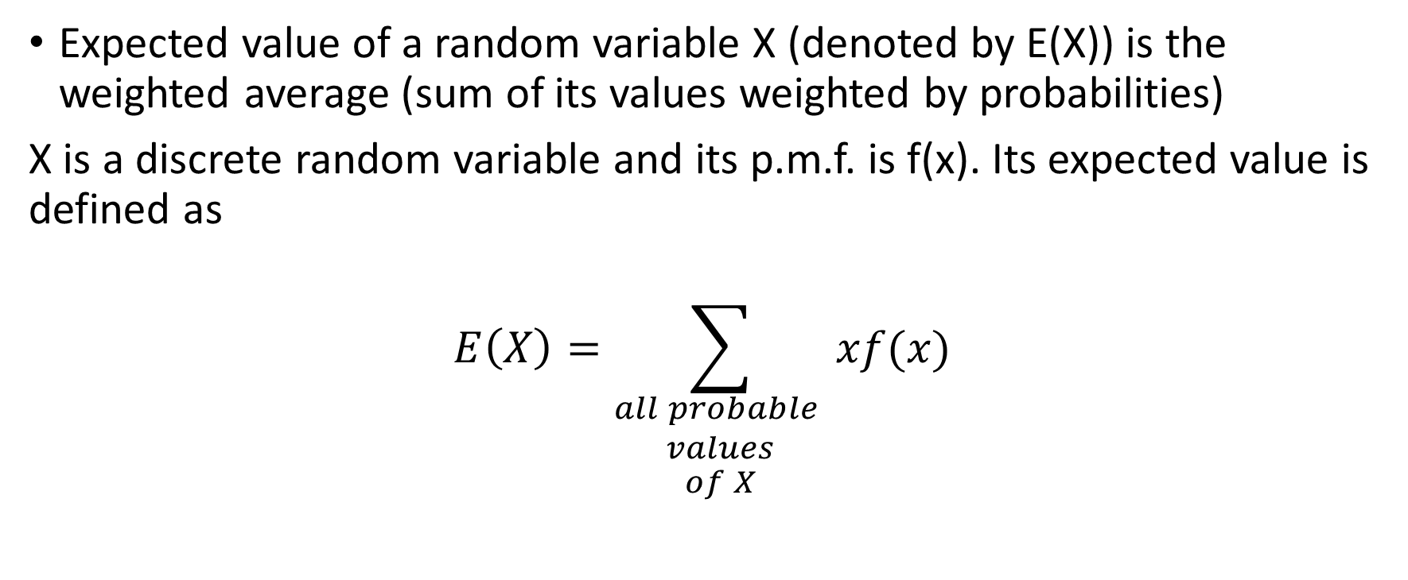
Expected value (discrete random variable)
Expected value of a random variable X (denoted by E(X)) is the weighted average (sum of its values weighted by probabilities)
X is a discrete random variable and its p.m.f. is f(x). Its expected value is defined as
$$E\left(X\right)=\sum_{\begin{aligned}all probable \\ values \\ of X\end{aligned}}{xf(x)}$$
* We will use “expected value,” “expectation,” “mean,” and “average” interchangeably

Slide 5
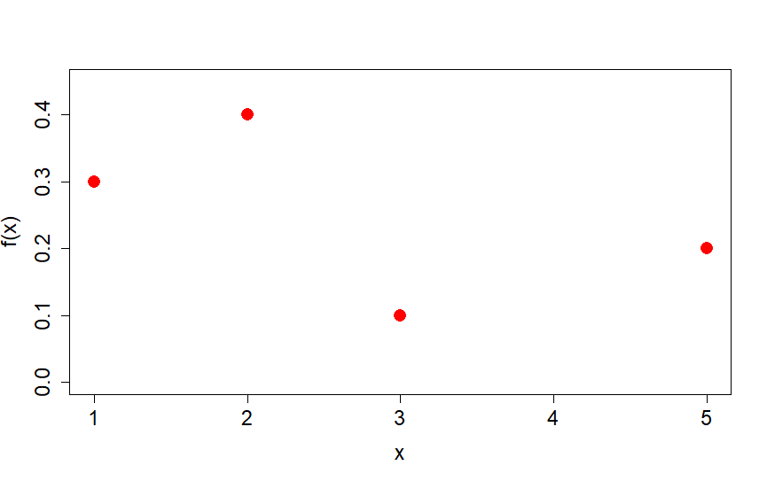


Example 1
Suppose X is the number of customers in an hour. What is $E\left(X\right)?$
$$E\left(X\right)=\sum_{\begin{aligned}all probable \\ values \\ of X\end{aligned}}{xf(x)}$$

Slide 6
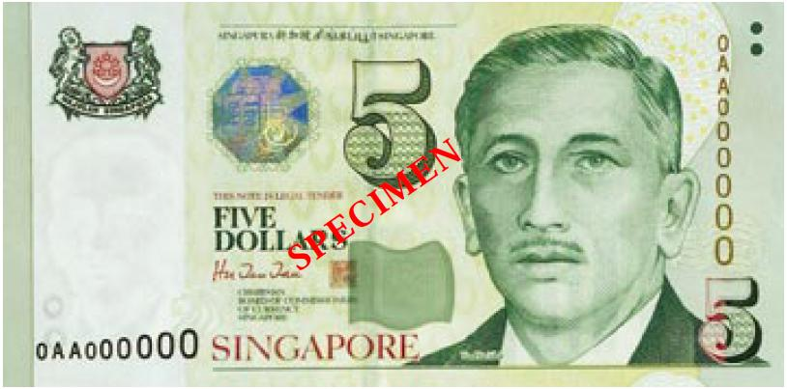
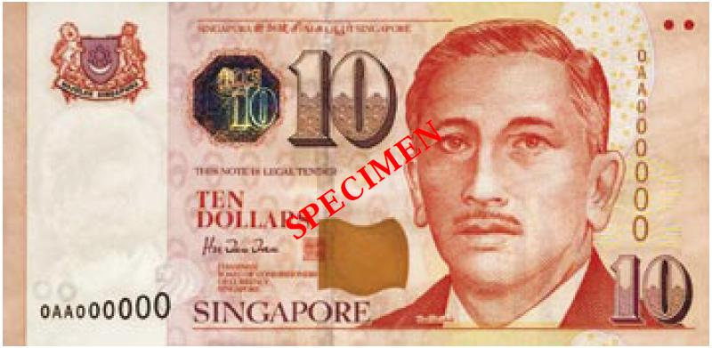
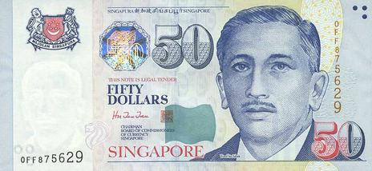
Example 2
You play a game with the following possible rewards and winning probabilities.
What is the expected reward from playing this game?
If you are charged $20 to play this game, what will be your expected “net reward”?
P=6/10
P=3/10
P=1/10

Slide 7
Pop quiz
For any discrete random variable X, verify the following statements:
It must hold that Pr(X=E(X))>0
E(X) must be the value most frequently seen in the experiment
E(X) has a probability distribution

Slide 8
Expected value of a function of a RV
If X is a random variable, the function of X will also be random variable
We define the number of customers / hour as a random variable X and we receive $10 from each customer. Then the “$” per hour will be a random variable (Y), with a distribution derived directly from that of X.
f(1)=0.3
f(2)=0.4
f(3)=0.1
f(5)=0.2

Slide 9

Expectation of a function of a RV
Suppose X is a discrete random variable. The expectation of g(X) is
$$E\left(g(X)\right)=\sum_{\begin{aligned}all probable values \\ of X\end{aligned}}{g(x)f(x)}$$
X
f(1)=0.3
f(2)=0.4
f(3)=0.1
f(5)=0.2

Slide 10
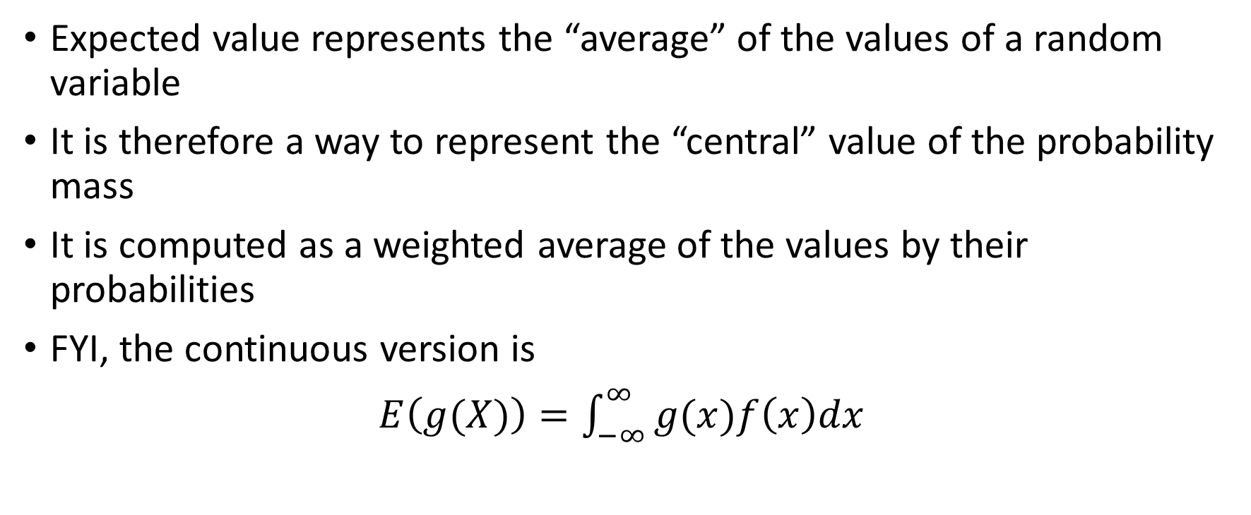
Summary
Expected value represents the “average” of the values of a random variable
It is therefore a way to represent the “central” value of the probability mass
It is computed as a weighted average of the values by their probabilities
FYI, the continuous version is
$E\left(g(X)\right)=\int_{−∞}^{∞}{g(x)f\left(x\right)dx}$

